Slide 1
Employee Data Analysis using Excel
Student Name: Janani S Register No :122202287
Department :Bachelor of Commerce (Corporate Secretaryship)
NM ID: 8A8B85F54A6D1AA1640BFAFF50311
College :Valliammal college for women

Slide 2
PROJECT TITLE
Employee Performance Analysis using Excel

Slide 3


AGENDA
1.Problem Statement 2.Project Overview 3.End Users
4.Our Solution and Proposition 5.Dataset Description 6.Modelling Approach 7.Results and Discussion 8.Conclusion
3/21/2024 Annual Review

Slide 4

PROBLEM STATEMENT
Analyze employee data using Excel to understand performance trends and improve decision-making. It also analyze employee data and understand performance trends.
Dates (Start and End Dates)
Supervisors- Contact Information
Employment Details (Employee Type, Pay Zone)
Employment Status (Termination)
Departments
Demographics (Birth Date, State)
Job Function
Location
Performance

Slide 5

PROJECT OVERVIEW
Analyze employee data using Excel to understand
performance trends and improve decision-making. It also an•a.lyze employee data and understand performance trends.
Dates (Start and End Dates)
Supervisors- Contact Information
Employment Details (Employee Type, Pay Zone)
Employment Status (Termination)
Departments
Demographics (Birth Date, State)
Job Function
Location
Performance

Slide 6



WHO ARE THE END USERS?

Slide 7

OUR SOLUTION AND ITS VALUE PROPOSITION
CONDITIONAL FORMATTING:
It is used to identify the missing elements
FILTERING:
It is used to remove the unwanted elements
FORMULA:
It is used to analyze the performance level
GRAPH:
It is used to represent the data visualization

Slide 8
Dataset Description
This description is about employee data analysis which is done through kaggle. It has 26 total features and in this data set it has involved 6 feature which includes;
Employee ID
First Name
Last Name
Business Unit
Gender
Employee Classification
Employee Status
Employee Type
Performance Score
Performance level.

Slide 9


THE "WOW" IN OUR SOLUTION
=IFS(Z8>=5,”VERY HIGH”,Z8>=4,’HIGH”,Z8>=4,”MED”,TRUE,”LOW”)
3/21/2024 Annual Review
9

Slide 10

MODELLING
DATA COLLECTION:
Collection of employees Id
Collection of employees Bio reference
DATA CLEANING:
Removing duplicates
Handling missing data
Correcting errors
PERFORMANCE LEVEL:
Used formulas to identify ratings
10

Slide 11
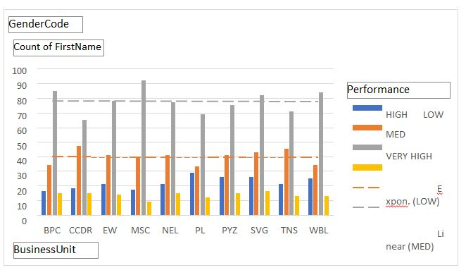
RESULTS
11

Slide 12
conclusion
In Summary, Our Employee Performance Analysis solution leverages Excel to transform complex data into actionable insights.
By organizing and summarizing performance metrics, comparing data across teams and periods and forecasting future trends, it provides a comprehensive view of employee performance.
The use of interactive dashboards and automated processes further simplifies data interpretation and decision-making.
This approach enhances productivity, improves workforce management, and supports informed strategic decisions, ultimately driving better organizational outcomes.

